Slide 1
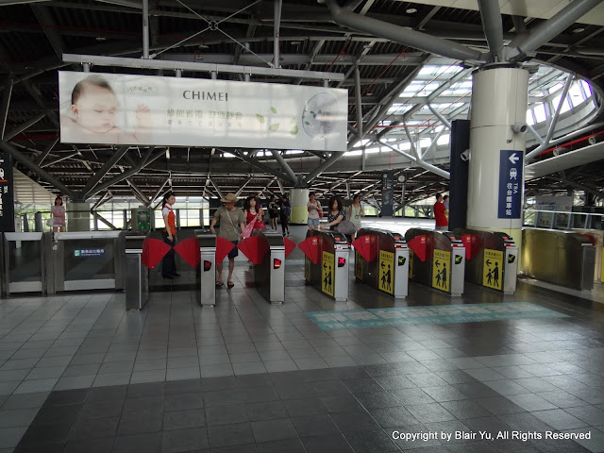
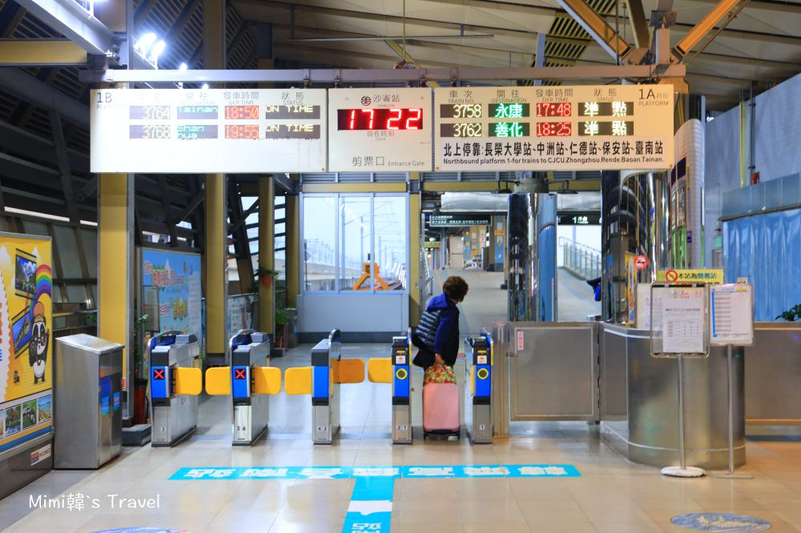
When Arrive at THSR Tainan Station
From Sunday (11/03) Morning 8:20 am,
Look for student helpers holding a sign “Welcome to MC/NC meeting at NCKU” outside THSR Exit;
They will guide you to Shalun Train Station, taking local train to Tainan (5 stops, ~22 min)
THSR
EXIT
Local Tran to Tainan
Shulun Station
Exit From THSR station,
Turn Left, 3 min walk to reach Shalun Station,
Check schedule for next train to Tainan, (ticket NT $25, 5 stops, ~22 min)

Slide 2
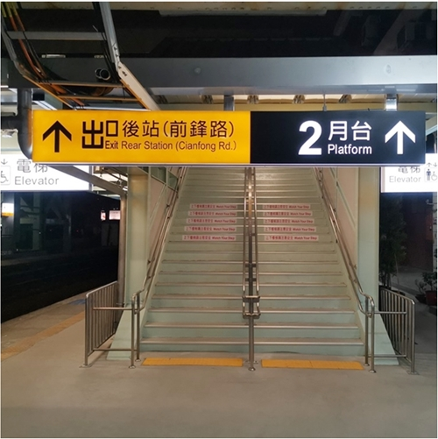
Arrival at Tainan Station (Local)
Get off train at Tainan Station,
In the opposite direction as the train arrives in, look for a stairs with sign “Exit Rear Station”,
Take elevator to 2F behind stairs.
Take Elevator
Behind stairs

Slide 3
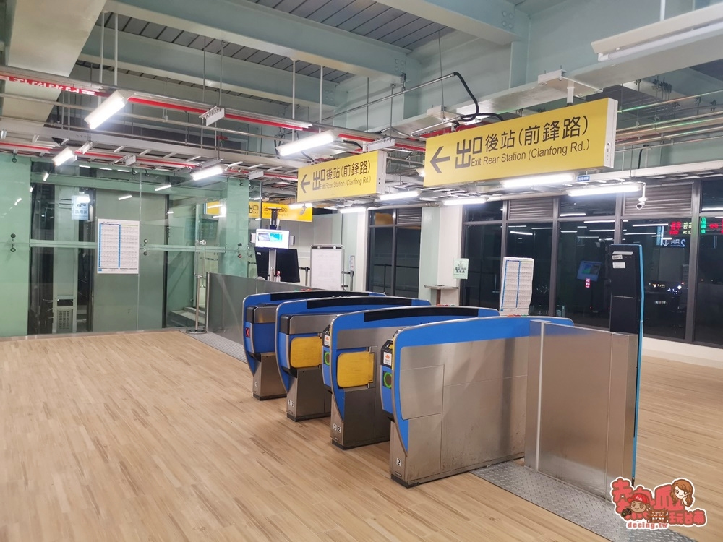
Exit at Tainan (Rear) Station
Exit from Tainan (Rear) Station at 2nd Floor,
Look for student helpers holding a sign “Welcome to MC/NC meeting at NCKU” outside Exit;
Take elevator to 1st F, They will guide you to Shangri-La Hotel. (Just cross street, a very tall building, 3 min walk)
If you stay at Academy Hotel,
Passing by Shangri-La Hotel, keep going straight for 450 meter, ~6 min walk,
Will see Academy Hotel at right.
If you stay at Hotel Tainan, also
Exit from Tainan (Rear) Station at 2nd Floor
Look for student helpers holding a sign “Welcome to MC/NC meeting at NCKU” outside Exit;
Student will guide you to Hotel Tainan (from Tainan (Front) Station, 5 min walk)

