Slide 1




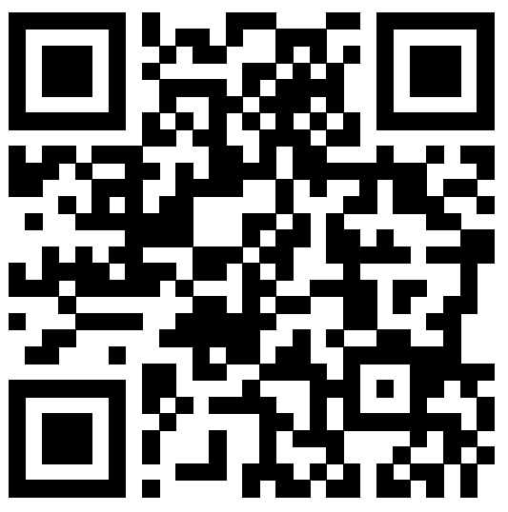



Publishing research from across all fields relevant to water research;
Covering research on water as a resource and the impact of society on water;
Topics include desalination, drinking water, wastewater treatment, water quality, and more;
Indexed by DOAJ.
Launched in 2021
Editor-in-Chief: Dr James LaMoreaux
Open Access
Downloads: 61,517 (2023)
Turnaround Time for Acceptance: 70 Days
Welcome your submissions!
springer.com/journal/43832

Slide 2

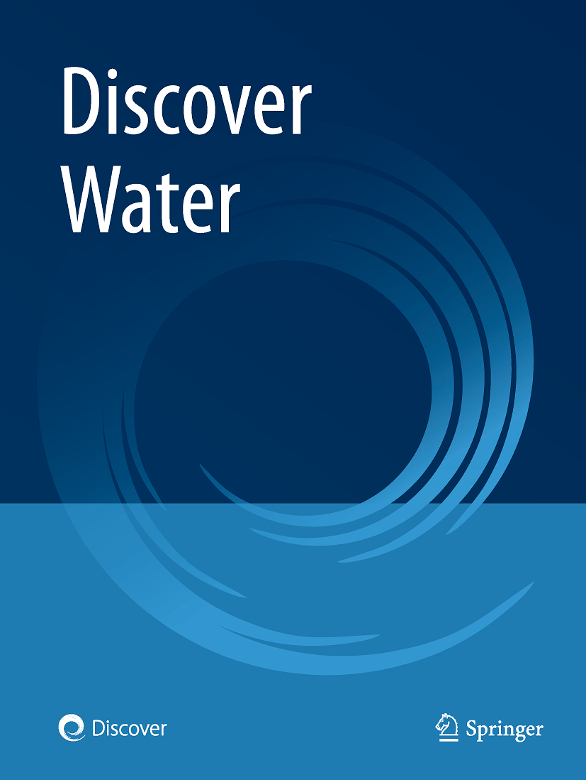
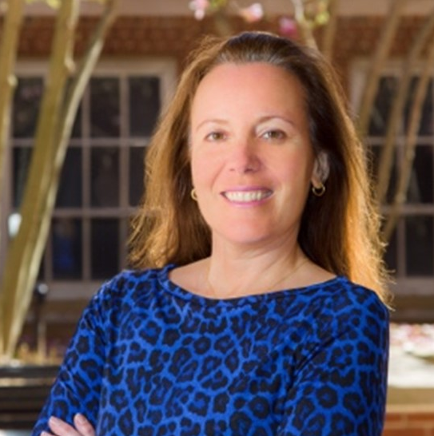
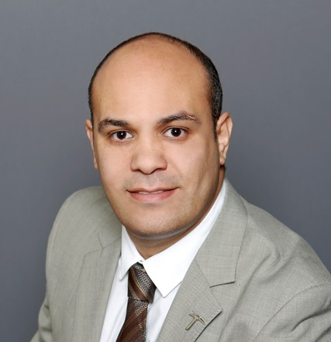
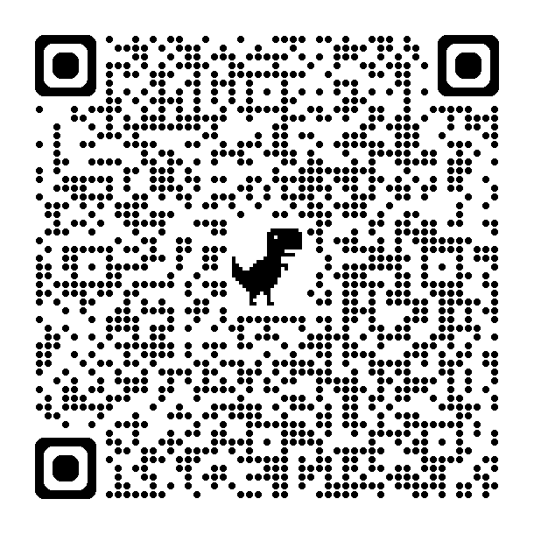

Discover Water
Open Call for Papers
Harnessing Nanotechnology: The Convergence for Sustainable Water Solutions
  Guest Edited by:
Prof. Isabel C. Escobar:
University of Kentucky, USA.
She has published over 100+ articles in peer-reviewed journals/book chapters and has made over 200 presentations at national/international conferences with >$20M grants to design novel membrane materials for difficult applications. She is the Chair of the Governing Board of the Association for Women In Science (AWIS), and Fellow of the North American Membrane Society (NAMS).
Assoc. Prof. Ahmed A. El-Gendy:
University of Texas at El Paso, USA.
He has published over 78+ articles in peer-reviewed journals/book chapters and has made over 100 presentations at national/international conferences with several external grants to design novel magnetic materials for different applications. His research interests include magnetism, hyperthermia, drug delivery, MRI, permanent magnets, water treatment, energy harvesting, molecular magnets.
Collection Summary: Currently nanotechnology plays a vital role in water purification techniques. For better water purification or treatment processes nanotechnology is preferred. Many different types of nanomaterials or nanoparticles are used in water treatment processes. Nanotechnology is used for numerous purposes in water remediation, treatment, difficult separations, and the removal of existing and emerging contaminants of interest, such as per- and polyfluoroalkyl substances (PFAS) and nanoplastics. There are variety of techniques in nanotechnology which uses nanoparticles for providing safe drinking water with a high level of effectiveness. The small size and unique properties of engineered nanomaterials are particularly promising for addressing the pressing technical challenges related to water quality and quantity.
Submission Deadline: 20 January 2025
To learn more about the Topical Collection and Discover Water,
please scan the QR Code to visit the website.
Contact Collection Managing Editor: Dr. Yutong Hu (yutong.hu@springernature.com)

